Slide 1
DAT 500S Module 10
Textbook Quiz:
Galit's Book – Problem 11.1
Group Assignment:
Galit's Book – Problem 11.3
Individual Assignment:
Galit's Book – Problem 11.4

Slide 2
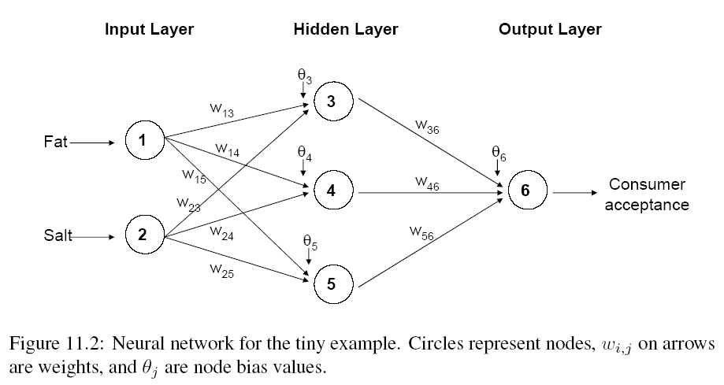
Module 10 – Neural Network

Slide 3
Module 10 – Neural Network
Output from output node k:
Error associated with that node:
Note: this is like ordinary error, multiplied by a correction factor
Multiplier
Error

Slide 4
Module 10 – Neural Network
l = constant between 0 and 1, reflects the “learning rate” or “weight decay parameter”

Slide 5
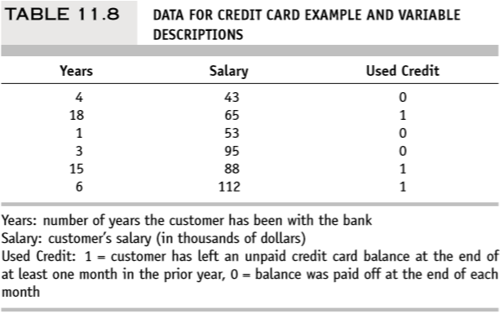
Quiz: Problem 11.1 – Credit Card Use
(a) Consider the following hypothetical bank data on consumers’ use of credit card credit facilities in Table 11.8. Create a small worksheet in Excel, like that used in Example 1, to illustrate one pass through a simple neural network.

Slide 6
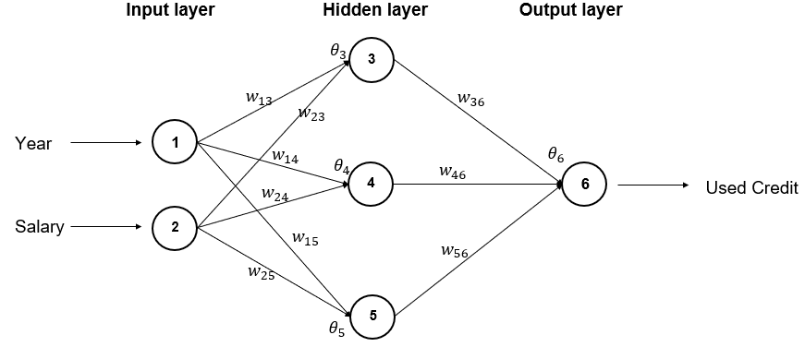
Quiz: Problem 11.1 – Credit Card Use
Neural Network structure:

Slide 7
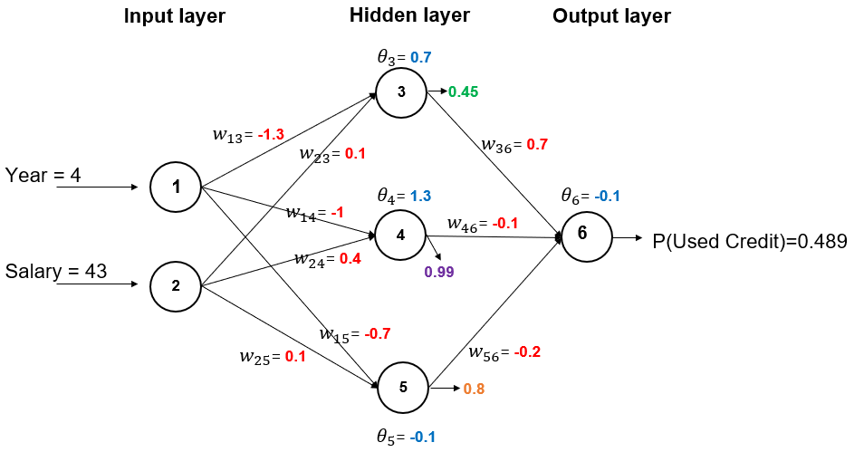

Quiz: Problem 11.1 – Credit Card Use
Assign random values to the weights(w) and bias($θ$), pass the first observation through, with sigmoid function as activation function

Slide 8

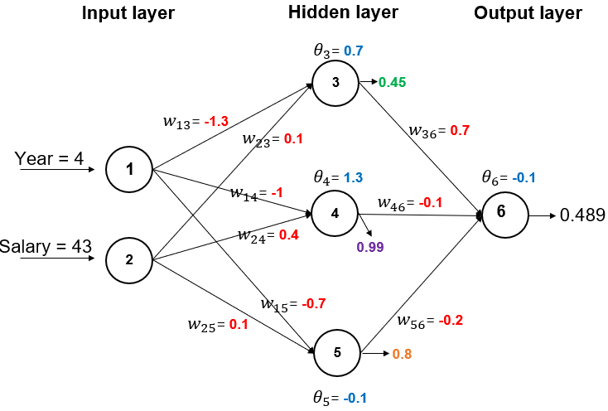

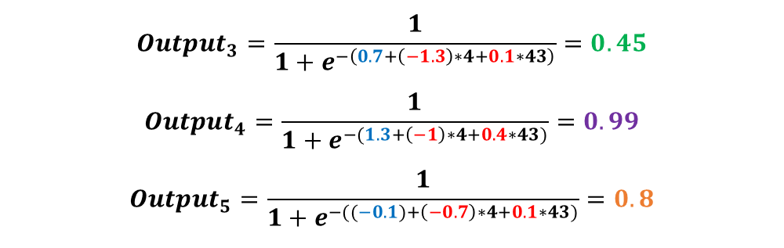
Quiz: Problem 11.1 – Credit Card Use
Assign random values to the weights(w) and bias($θ$), pass the first observation through, with sigmoid function as activation function
$${Output}_{3}=\frac{1}{1+e^{−\left(0.7+\left(−1.3\right)∗4+0.1∗43\right)}}=0.45$$
$${Output}_{4}=\frac{1}{1+e^{−(1.3+\left(−1\right)∗4+0.4∗43)}}=0.99$$
$${Output}_{5}=\frac{1}{1+e^{−((−0.1)+\left(−0.7\right)∗4+0.1∗43)}}=0.8$$
$${Output}_{6}=\frac{1}{1+e^{\left.−(\left(−0.1\right)+0.7∗0.45+\left(−0.1\right)∗0.99+\left(−0.2\right)∗0.8\right)}}=0.489$$

Slide 9
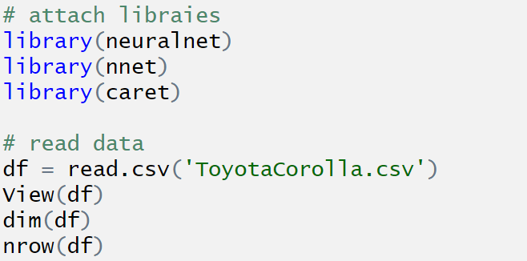
Group Assignment: Problem 11.3 – Car Sales
Consider the data on used cars with 1436 records and details on 38 attributes, including Price, Age, KM, HP, and other specifications. The goal is to predict the price of a used Toyota Corolla based on its specifications.

Slide 10
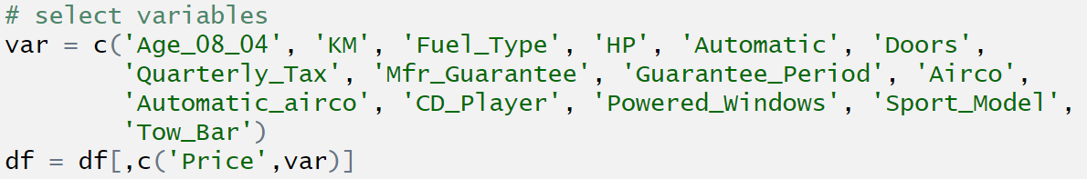
Group Assignment: Problem 11.3 – Car Sales
Use predictors Age_08_04, KM, Fuel_Type, HP, Automatic, Doors, Quarterly_Tax, Mfr_Guarantee, Guarantee_Period, Airco, Automatic_airco, CD_Player, Powered_Windows, Sport_Model, and Tow_Bar.

Slide 11
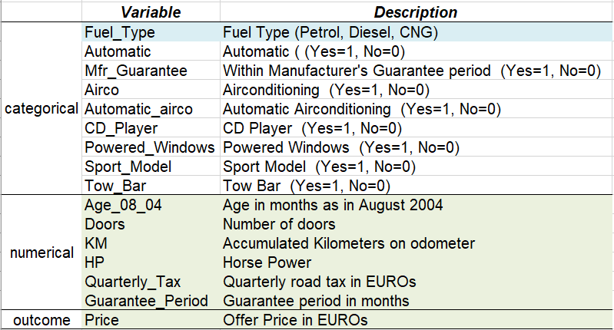
Group Assignment: Problem 11.3 – Car Sales
Scale the numerical predictor and outcome variables to a 0-1 scale
(use function preprocess() with method=“range” )
Convert categorical predictors to dummies.
Read variable description
→ convert to dummies
already in 0,1 (2 classes)
scale to 0-1

Slide 12
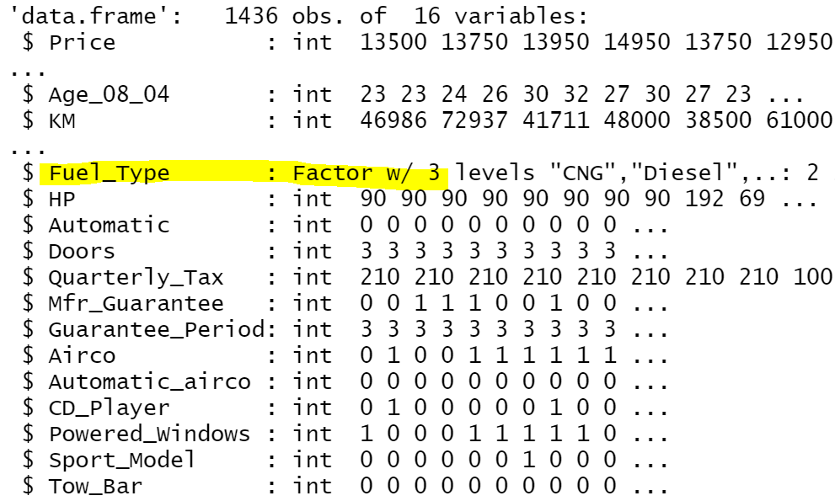
Group Assignment: Problem 11.3 – Car Sales
Scale the numerical predictor and outcome variables to a 0-1 scale
(use function preprocess() with method=“range” )
Convert categorical predictors to dummies.
Use str() function
to check variable type
→ str(df)

Slide 13
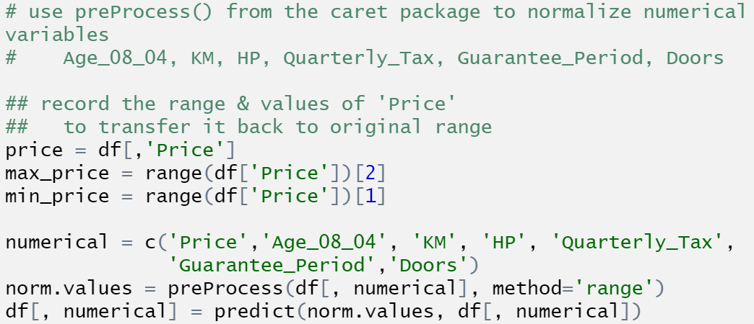
Group Assignment: Problem 11.3 – Car Sales
Scale the numerical predictor and outcome variables to a 0-1 scale
(use function preprocess() with method=“range” )
Used in computing RMSE

Slide 14
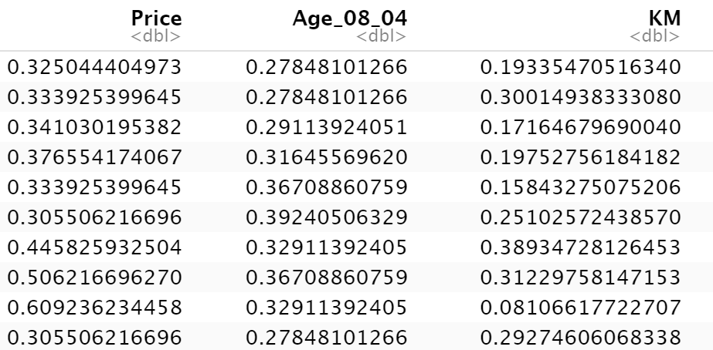
Group Assignment: Problem 11.3 – Car Sales
Scale the numerical predictor and outcome variables to a 0-1 scale
(use function preprocess() with method=“range” )

Slide 15
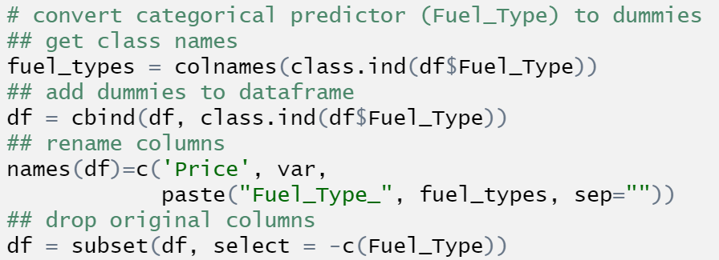
Group Assignment: Problem 11.3 – Car Sales
Convert categorical predictors to dummies.

Slide 16
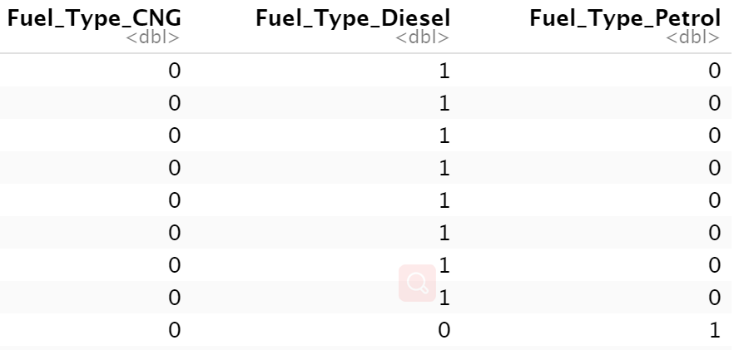
Group Assignment: Problem 11.3 – Car Sales
Convert categorical predictors to dummies.

Slide 17
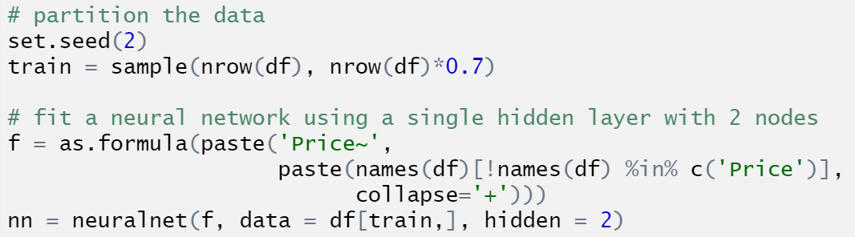
Group Assignment: Problem 11.3 – Car Sales
Fit a neural network model to the data. Use a single hidden layer with 2 nodes.

Slide 18
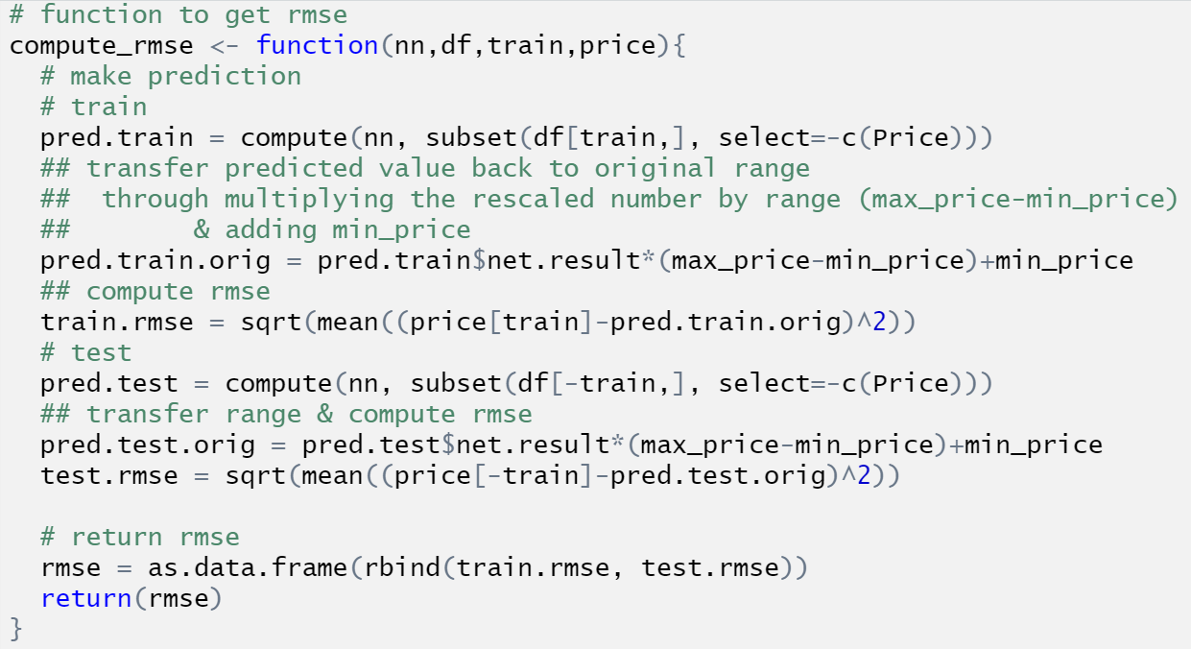
Group Assignment: Problem 11.3 – Car Sales
Record the RMS error for the training data and the validation data.
The original price data before scaling
Exclude outcome variable
Compute RMSE based on values in the original scale instead of the scaled values in (0,1)

Slide 19

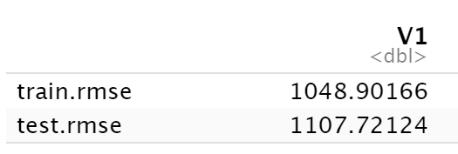
Group Assignment: Problem 11.3 – Car Sales
Record the RMS error for the training data and the validation data.

Slide 20
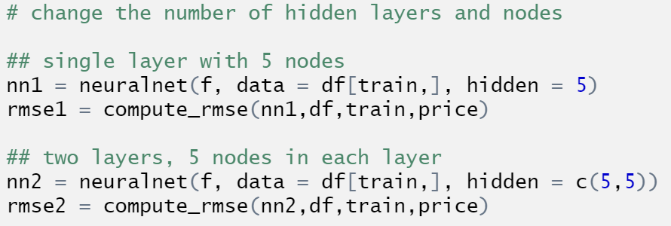
Group Assignment: Problem 11.3 – Car Sales
Repeat the process, changing the number of hidden layers and nodes to {single layer with 5 nodes}, {two layers, 5 nodes in each layer}.
Use vector of integers to represent number of nodes in each hidden layers

Slide 21
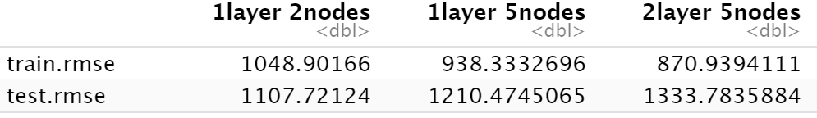
Group Assignment: Problem 11.3 – Car Sales
Repeat the process, changing the number of hidden layers and nodes to {single layer with 5 nodes}, {two layers, 5 nodes in each layer}.

Slide 22
Group Assignment: Problem 11.3 – Car Sales
1. What happens to the RMS error for the training data as the number of layers and nodes increases?
2. What happens to the RMS error for the validation data?
3. Comment on the appropriate number of layers and nodes for this application.

